Slide 1
Finding Your Shadow
Shadow Mirror | 影の鏡
Stewart Gray III
Stanford University
teamLab Summer Intern 2017
ステュワート グレイ III
スタンフォード大学
チームラボ 夏のインタ―ン2017
Notes:
Greeting -> Name -> Student -> “This summer, I was…” International Intern, Interactive Team

Slide 2
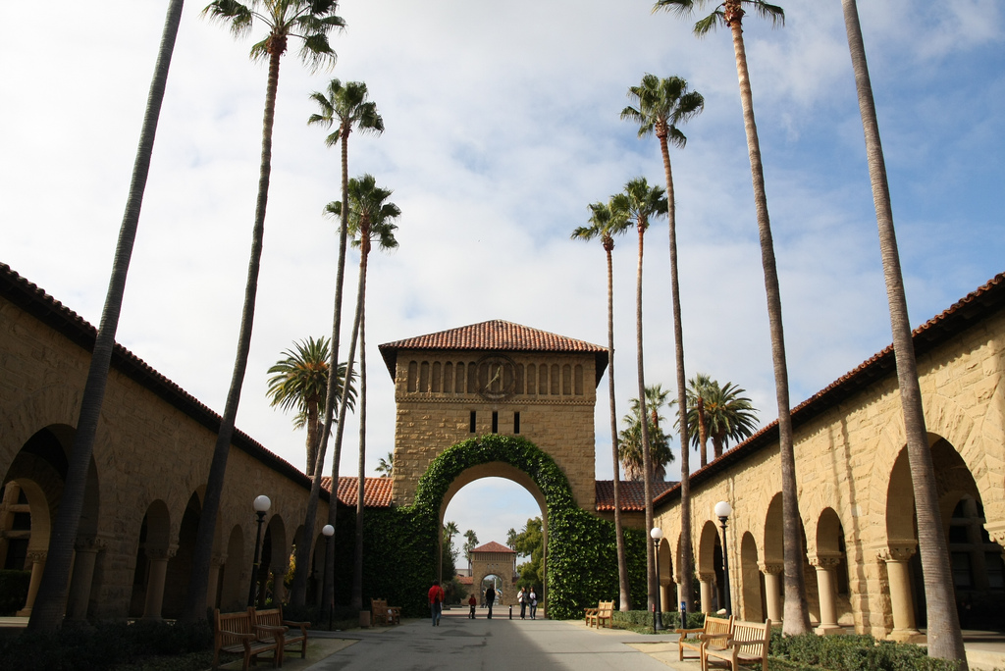
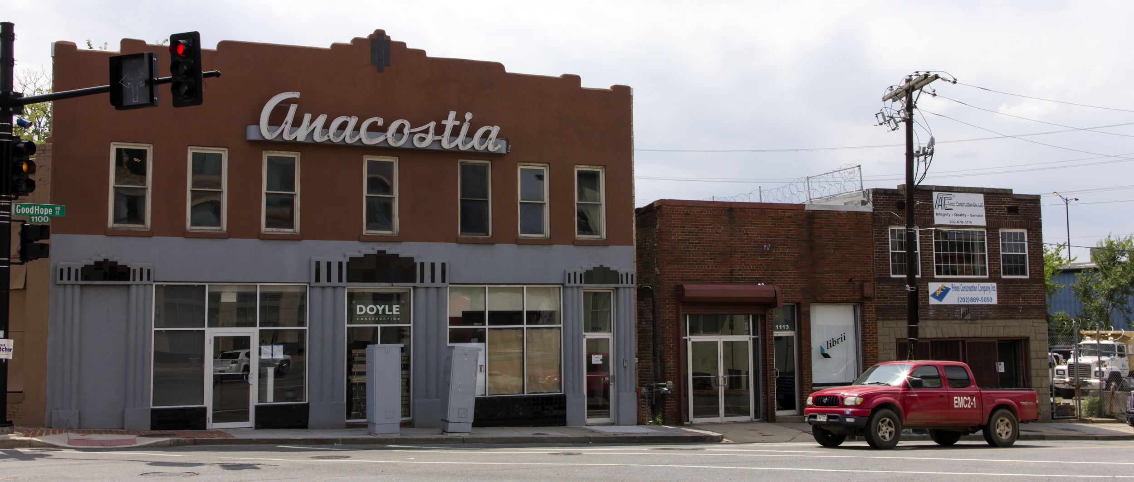
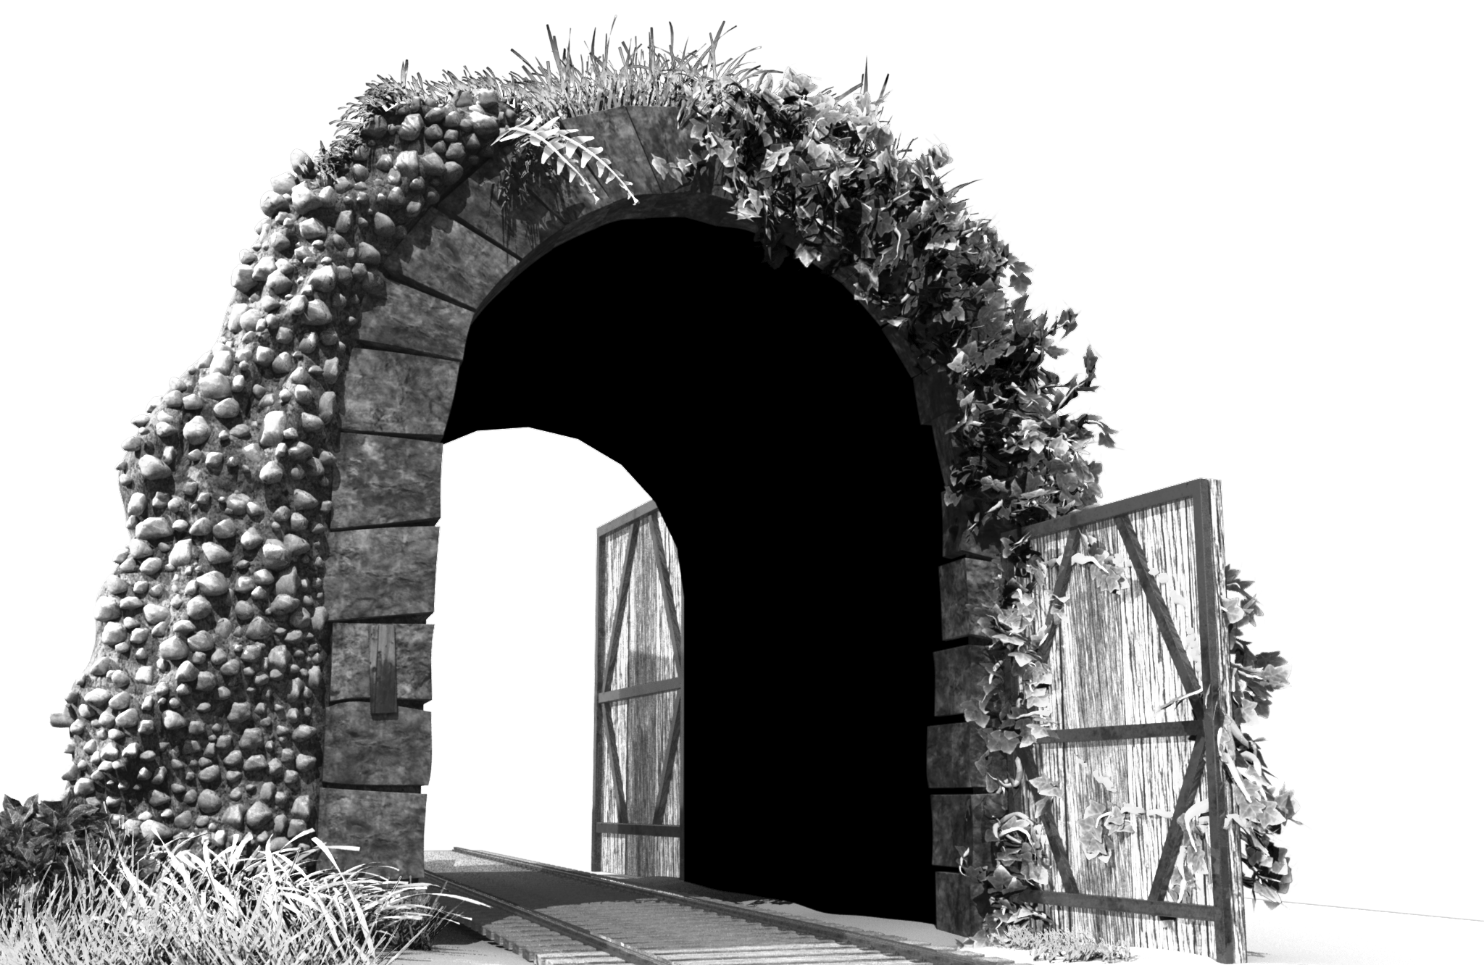
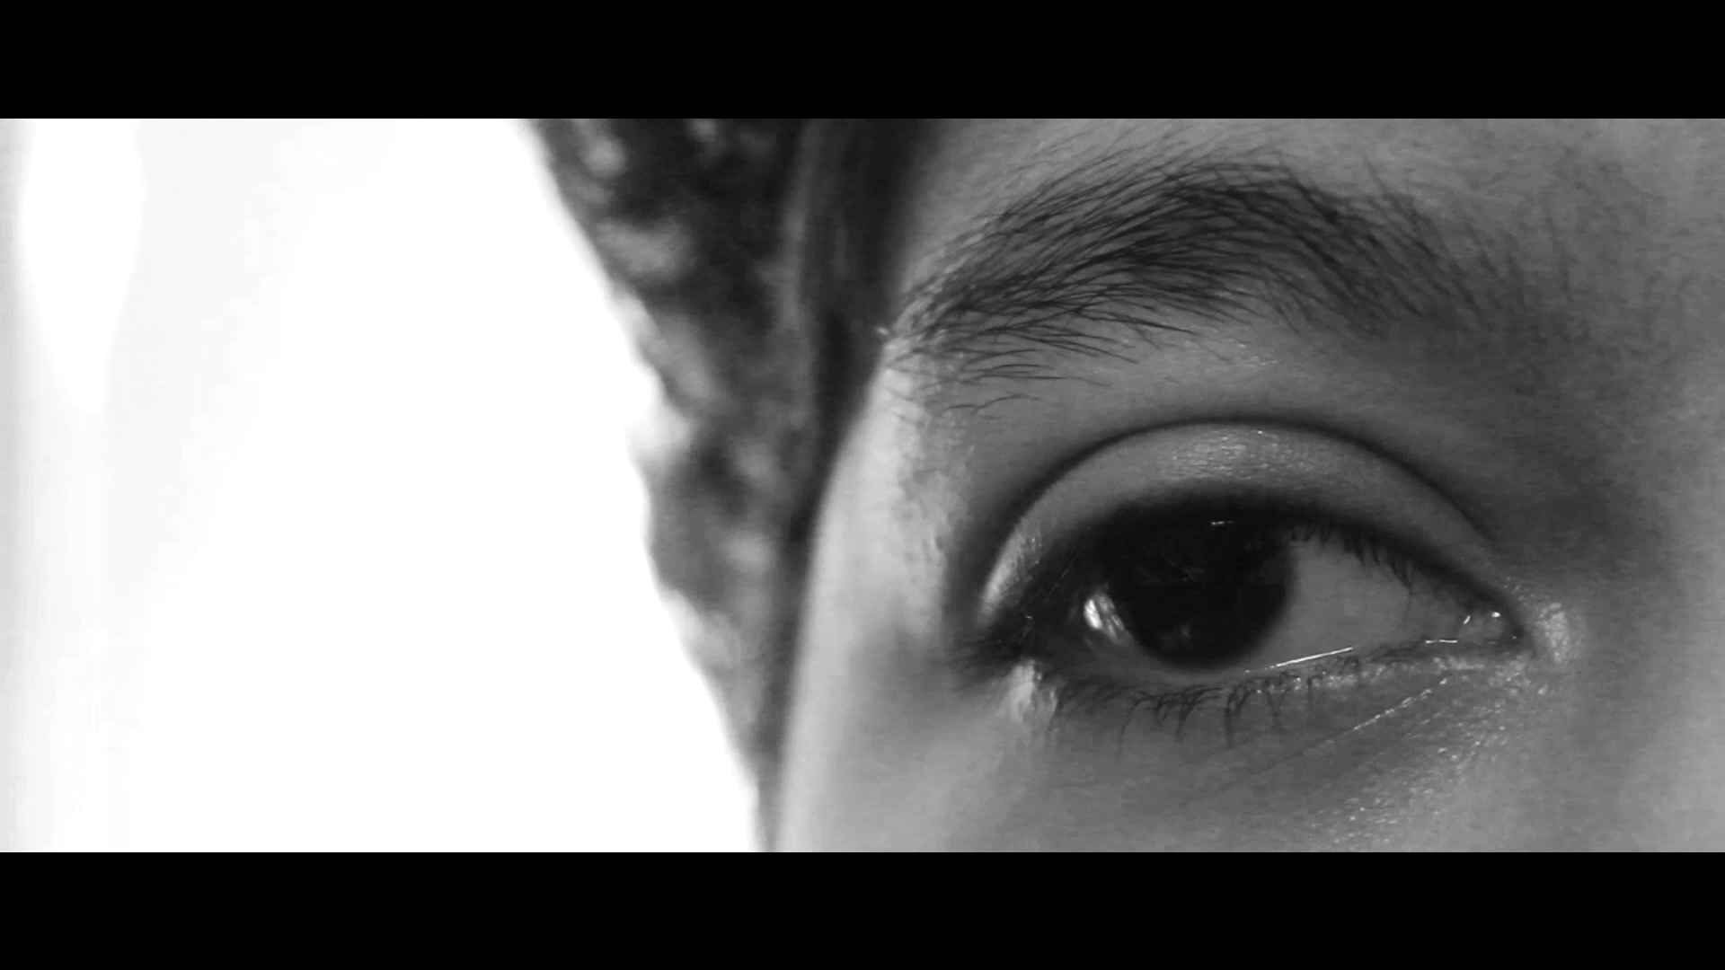
About Me | 私について
Notes:
Anacostia, Washington DC. Historical Neighborhood. Not mentioned, read up on it.
Stanford, 2014, Art and CS
Still of Maya and Film work, which leads to...

Slide 3
Concept | コンセプト
Looking in a mirror, we see our external selves
What if one could represent the internal parts of ourselves that we try to hide?
The Shadow
影

Slide 4
Visual Reference | ビデオ
ICO, Sony Computer Entertainment 2001
Notes:
ICO, 2001.
Shadows as spiritual, ethereal presence.
Want to capture body w/Kinect...

Slide 5
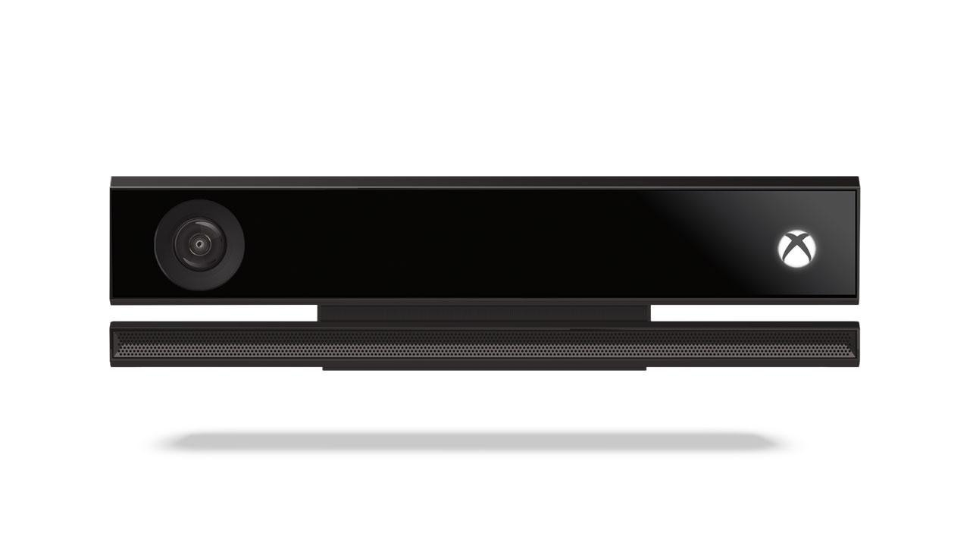
Meeting the Kinect | Kinectを使う初めて
Microsoft Kinect v2
RGB Sensor
Notes:
Powerful, Webcam with depth

Slide 6
Meeting the Kinect | Kinectを使う初めて
Microsoft Kinect v2
RGB Sensor
Depth Sensor
(Opens up a world of possibilities!)

Slide 7
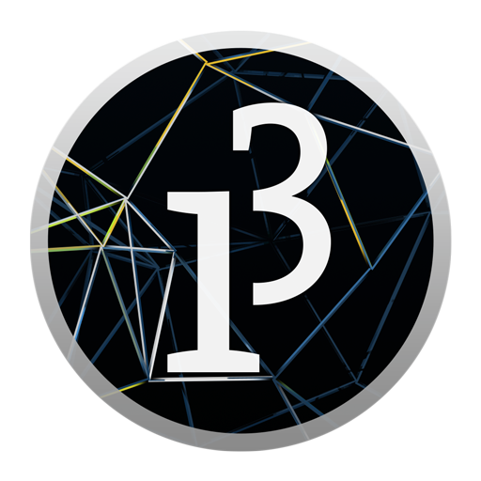
Prototyping | プロトタイプ
Processing 3.0
Lightweight
Easy to use
Quick integration with Kinect v2.0

Slide 8
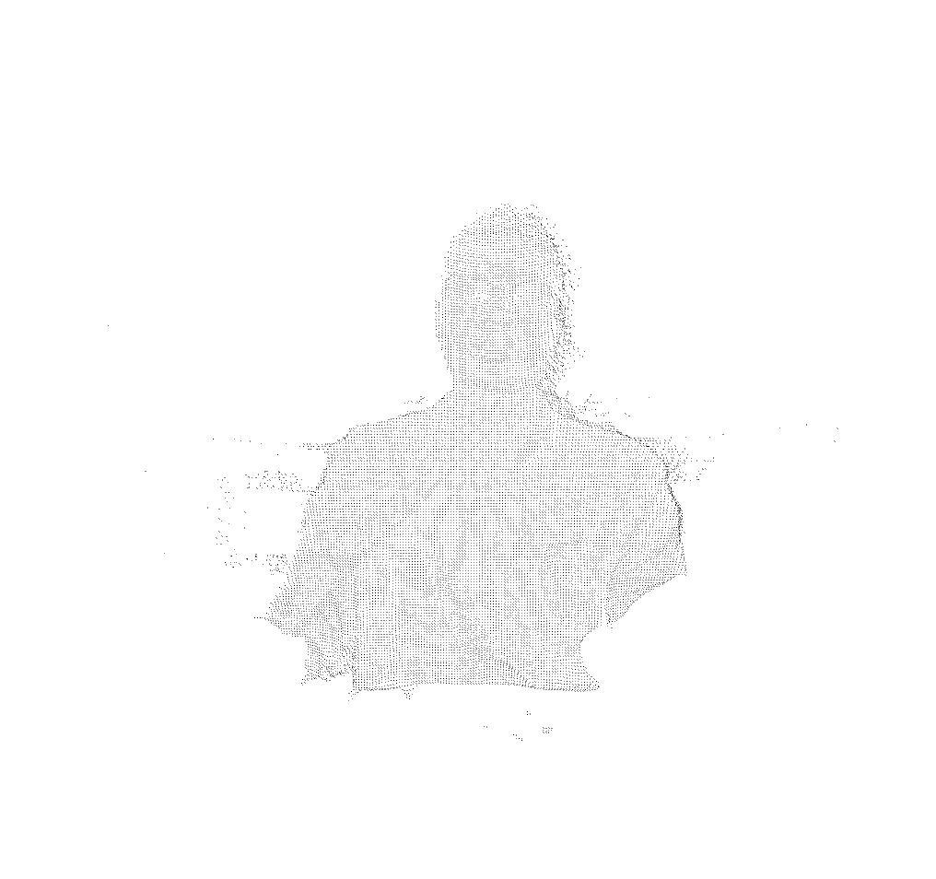
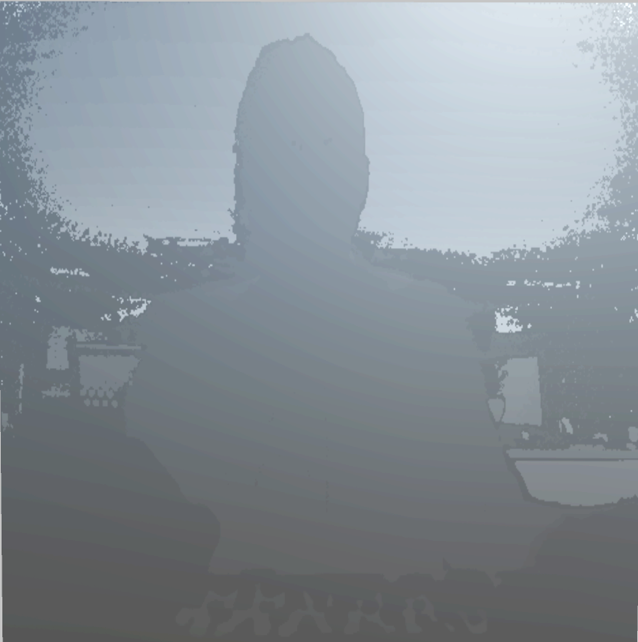
Generating a Point Cloud | Point Cloudを作っています
//Iterate through all the pixels
for (int x = 0; x < DEPTH_WIDTH; x++) {
for (int y = 0; y < DEPTH_HEIGHT; y++) {
//Index each pixel
int index = x + y * DEPTH_WIDTH;
int z = depthArray[index];
//Virtual to Physical Space
Vector3 point = pointToWorld(x, y, z);
//Render the pixels inside THRESHOLD
if (z is inside THRESHOLD) {
vertex(point.x, point.y, point.z );
}
}
}
Depth Image
Point Cloud
Notes:
Loop through depth map
Convert each pixel (2D space) to world (3D space)
If the pixel is in our threshold, display it
Image is still, just tracks, no animation

Slide 9
How do we animate the cloud?

Slide 10
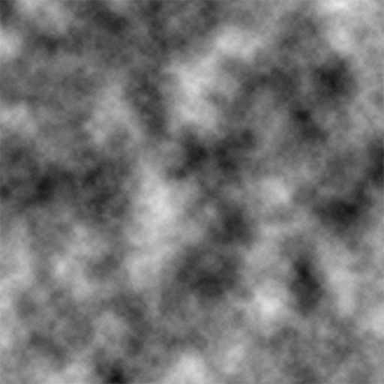
Integration with Noise |Perlinノイズ
Perlin Noise
Used to generate pseudo-random numbers from [-1, 1]
Useful for terrain generation (ie: Heightmaps)
Can also be used to create flow fields
Notes:
Used in real time rendering often, such as modelling terrains and simulating smoke, water, etc.
Can generate vectors...ie: flow field, series of moving vectors that objects can follow

Slide 11

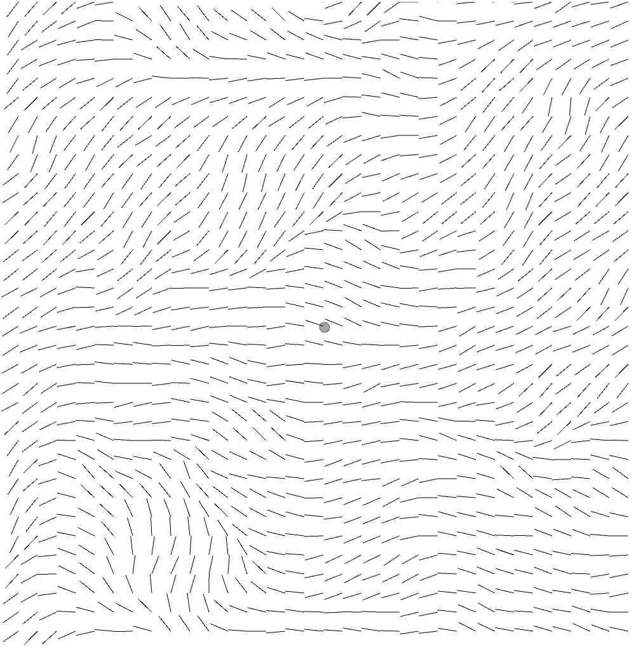
Noise and Flow Fields | ノイズと Flow Field
Float t = 0.0001;
Float millis = time.deltaTime()
float xOff = 0;
for (int x = 0; x < WIDTH/SCALE; x++) {
float yOff = 0;
for (int y = 0; y < HEIGHT/SCALE; y++) {
//Obtain the index of each vector in the field
int index = x + y * WIDTH/SCALE;
//Remap theta from [0,1] to [0, 16PI]
float theta = map(noise(xOff, yOff, millis * t), 0, 1, 0, TWO_PI * 16);
yOff += 0.1;
Vector3 v = Vector3.fromAngle(theta);
field[index] = v;
}
xOffset += 0.1;
}
Empty screen
Screen full of moving vectors!
Notes:
Starting with an empty screen, divide screen width and resolution by scale (find number of vectors per pixel)
Generate an angle from noise (offsets, with time as the third dimension)
Generate vector from angle

Slide 12
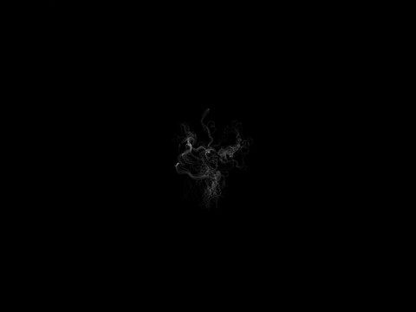
Flow Fields and Particle Systems | Flow Fieldとパーティクルシステム
Notes:
About 10 seconds

Slide 13
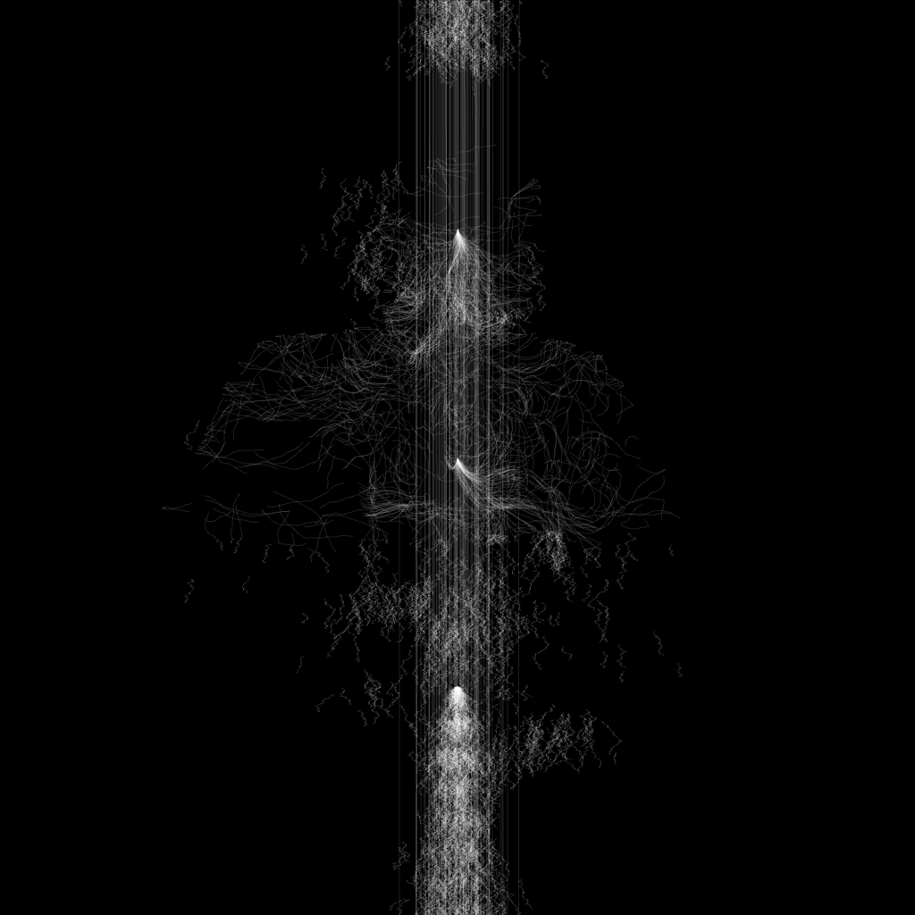
Merging the Two | Point CloudとPerlinを交える
Particle Flow Field in shape of Point Cloud
Notes:
Combining the two results in an unclear image, good thing we have…

Slide 14
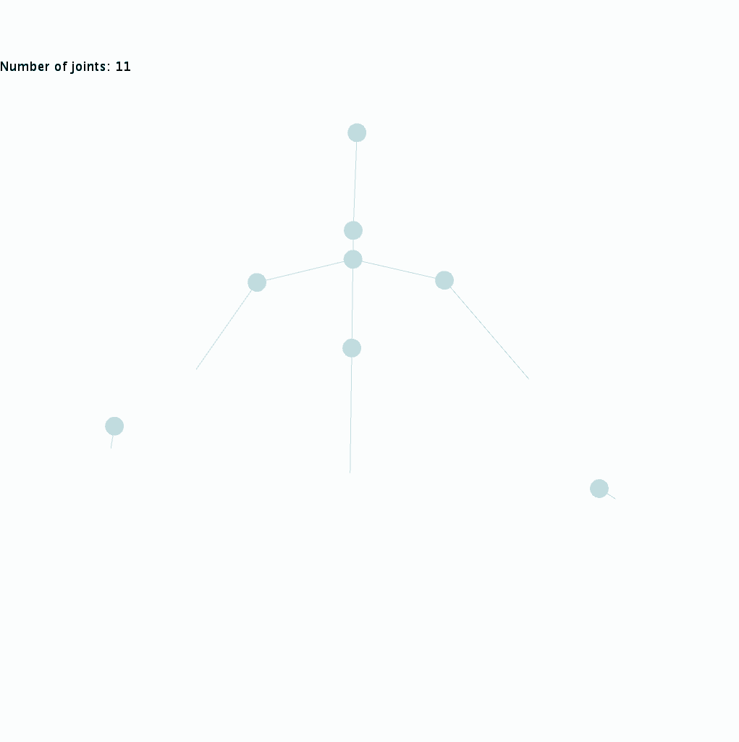
Joints - A Clearer Image | ジョイントのデータ
With Processing, we can access (almost) all of the Kinect’s API functions, including the skeleton!
Notes:
...bones!

Slide 15
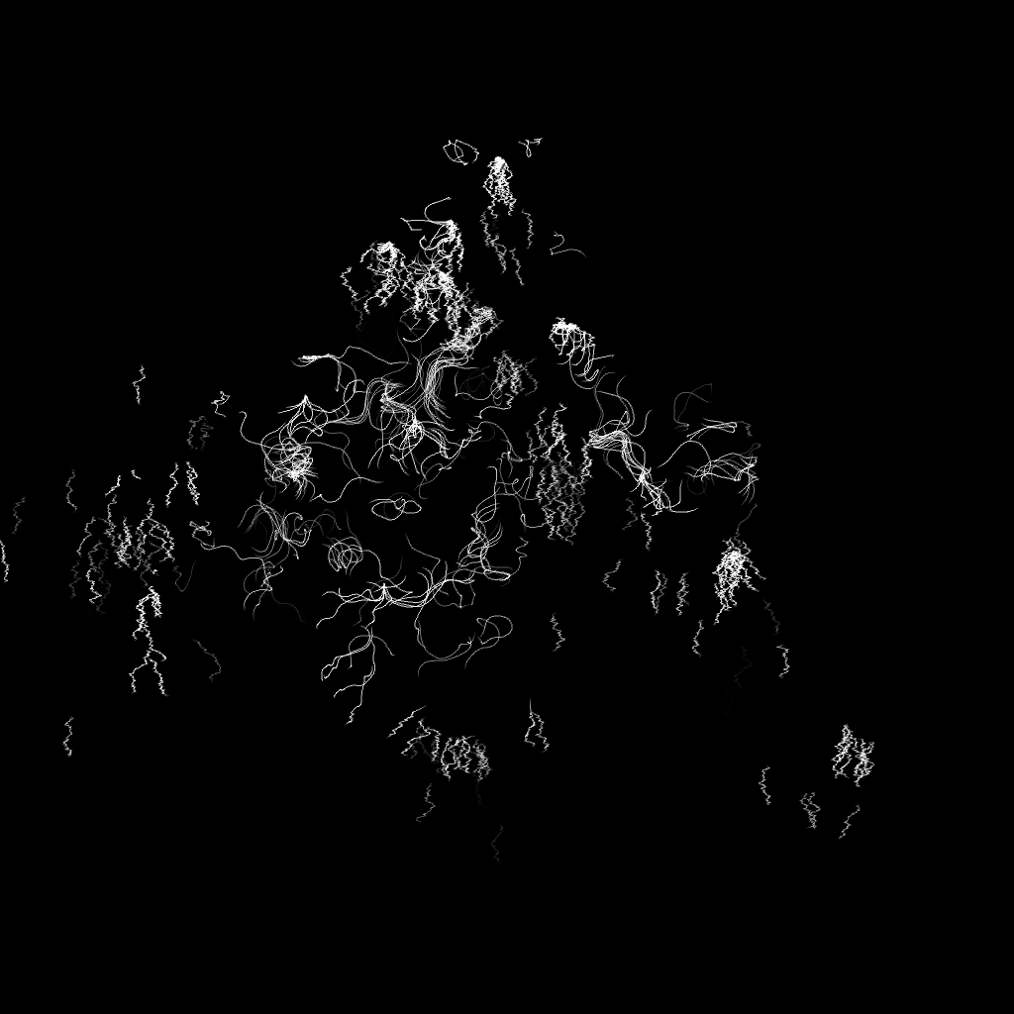
Particle System from skeleton joints

Slide 16
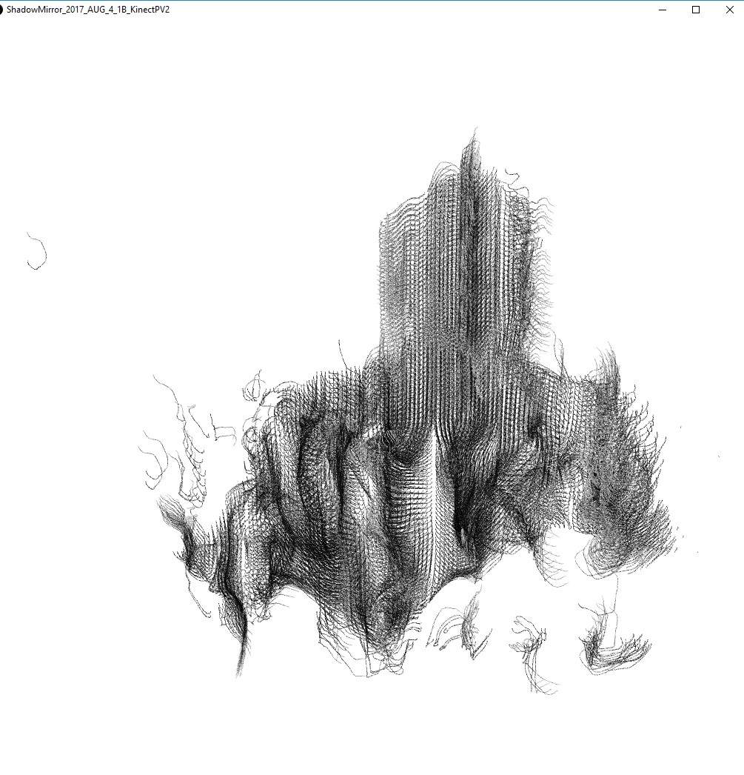
Modifying the Particles |パーティクルを変更しています
Instead of having particles conform to the shape of the point cloud, have particles emit from the point cloud.
Average FPS: 5

Slide 17

Transition to Unity | Unityに移行
Unity 2017
More Power
Greater flexibility
Easy Access to Microsoft’s Kinect SDK - no third party alternatives!

Slide 18
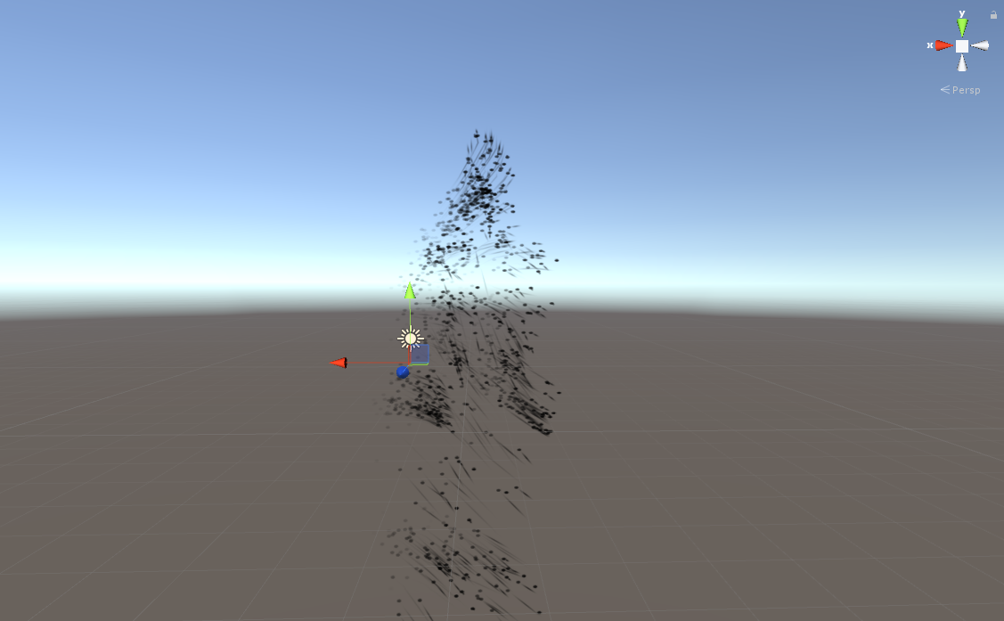
Emitting Particles from Mesh | Meshから、パーティクルを生まれる
Unity can emit particles from mesh vertices
Test with “Ethan” mesh in Unity’s Standard Assets
Smooth Performance
Unity’s Particle System has its own noise implementation
Sounds Ideal!

Slide 19
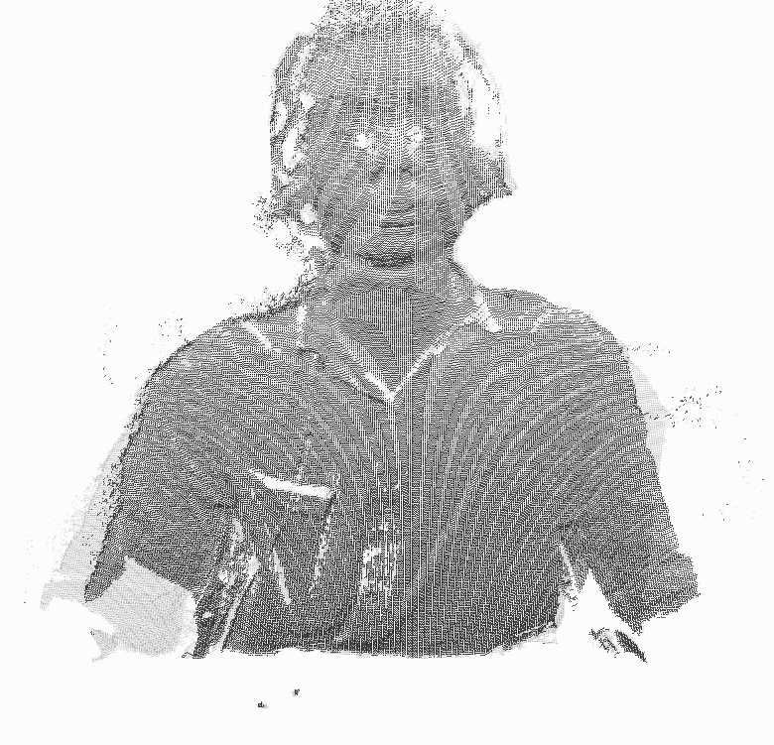
Unity’s Mesh Class to Create Point Cloud | Unityでメッシュ生成
Mesh tmp = new Mesh();
...
List<Vector3> verts = new List<Vector3>();
List<int> inds = new List<int>();
//Same indexing and conversion as before
if (Index inside Threshold)
{
Add points to verts
Add current index to inds
}
}
}
//Complete the creation of the mesh
Mesh vertices = verts list
Mesh indices = inds (as points)
return tmp;
Notes:
Same method as before, now just using Unity’s mesh class to set vertices

Slide 20
Problem | 問題
Point Cloud is not a Static Mesh
Integration with Particle System Not Possible
Solution?
Modify Point Cloud Vertices

Slide 21
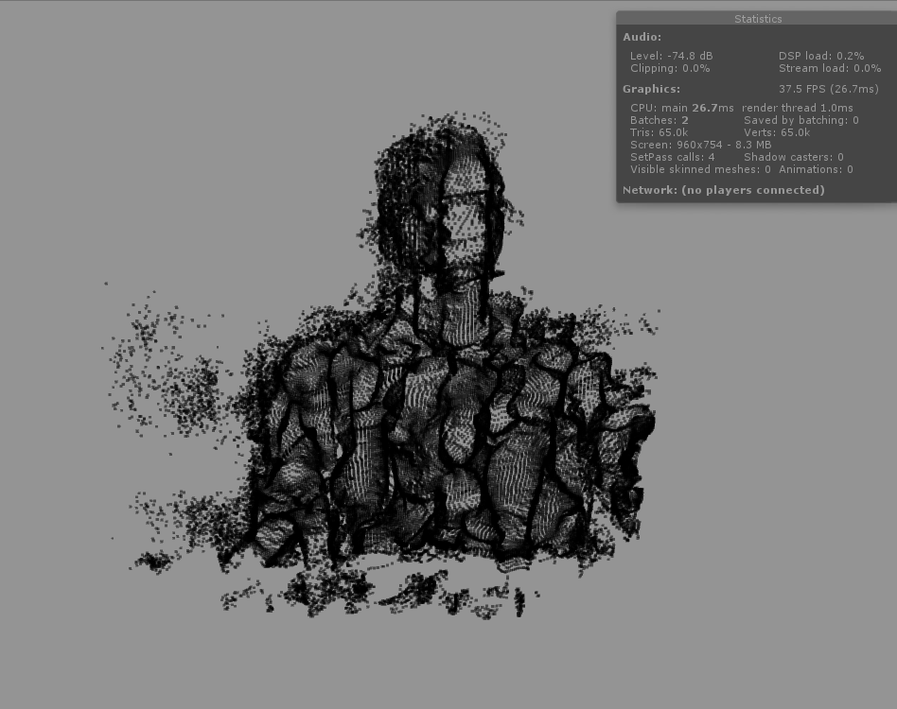
The Wonderful World of Shaders | 綺麗なシェーダー
float3 curl(float x, float y, float z) {
float eps = 1.0f;
float n1, n2, a, b;
float3 curl;
//Calculating the change of X
n1 = snoise(float3(x, y + eps, z));
n2 = snoise(float3(x, y - eps, z));
a = (n1 - n2) / (2.0f * eps);
n1 = snoise(float3(x, y, z + eps));
n2 = snoise(float3(x, y, z - eps));
b = (n1 - n2) / (2.0f * eps);
curl.x = a - b;
...
return curl;
}
Point Cloud after applying curl noise to Vertex Shader
float3 curl(float x, float y, float z) {
float eps = 1.0f;
float n1, n2, a, b;
float3 curl;
//Calculating the change of X
n1 = snoise(float3(x, y + eps, z));
n2 = snoise(float3(x, y - eps, z));
a = (n1 - n2) / (2.0f * eps);
n1 = snoise(float3(x, y, z + eps));
n2 = snoise(float3(x, y, z - eps));
b = (n1 - n2) / (2.0f * eps);
curl.x = a - b;
//Calculating the change of Y
n1 = snoise(float3(x, y, z + eps));
n2 = snoise(float3(x, y, z - eps));
a = (n1 - n2) / (2.0f * eps);
n1 = snoise(float3(x + eps, y, z));
n2 = snoise(float3(x + eps, y, z));
b = (n1 - n2) / (2.0f * eps);
curl.y = a - b;
//Calculating the change of Z
n1 = snoise(float3(x + eps, y, z));
n2 = snoise(float3(x - eps, y, z));
a = (n1 - n2) / (2.0f * eps);
n1 = snoise(float3(x, y + eps, z));
n2 = snoise(float3(x, y - eps, z));
b = (n1 - n2) / (2.0f * eps);
curl.z = a - b;
return curl;
}
Notes:
3D Curl Noise
Calculate two noise samples for two gradients. Subtract the gradients for each axis to find noise.
Curl is an operator. Image very cluttered

Slide 22
Reducing Artifacts Pt. 1 - Pixel Clipping | 画像を掃除してる
Mesh tmp = new Mesh();
Vector3 point = new Vector3(0, 0, 0);
...
for (int x = 0; x < width; x ++)
{
for (int y = 0; y < height; y ++)
{
Vector3 prevPoint = point;
point = toCamera(x, y, z);
if (Index inside Threshold &&
pixelDifference(prevPoint, point) < CLIP)
{
//Add point to mesh
}
}
}
...
float pixelDifference(Vector3 p1, Vector3 p2)
{
return (p2 - p1);
}
Notes:
Save a copy of the previous point in the cloud each frame
Calculate difference between current and previous point
If it’s less than our clipping threshold, include it in the mesh

Slide 23
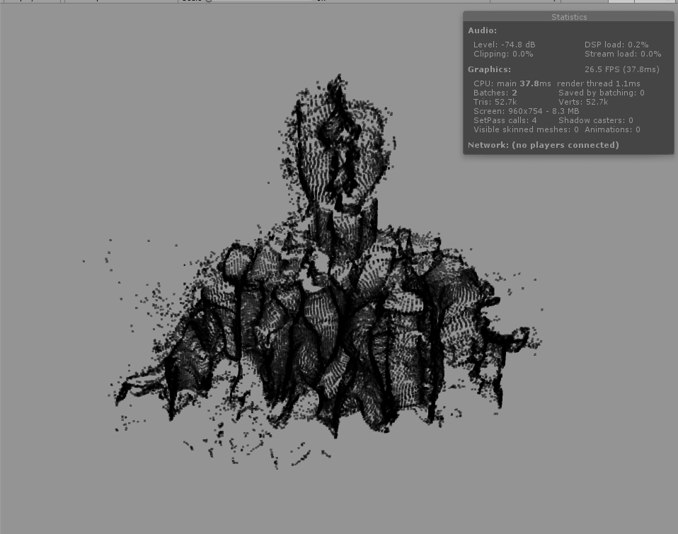
Reducing Artifacts Pt. 1 - Pixel Clipping | 画像を掃除してる
Pixel Difference Off
Pixel Difference On

Slide 24
Reducing Artifacts Pt. 2 - Value System | 画像を掃除してる
...
List<Vector2> uv = new List<Vector2>();
...
float v = vismarks[x,y];
if (Index inside Threshold)
{
v += INC;
}
else
{
v -= INC2;
}
if (verts.Count < MAX_VERTS && v >= VIS_THRESH)
{
verts.Add(point);
uv.Add(new Vector2((v - VIS_THRESH) * 2.0f, 0));
}
vismarks[x, y] = Mathf.Clamp01(v);
}
}
...
Notes:
Using a separate array, we measure consistency of each point that passes our first threshold
The more consistent a point is, it will increment.
The less consistent a point is, it will decrement.
If a point is above a certain threshold, display it. *Clamp from 0 to 1 for normalization, UVs to link opacity to point visibility

Slide 25
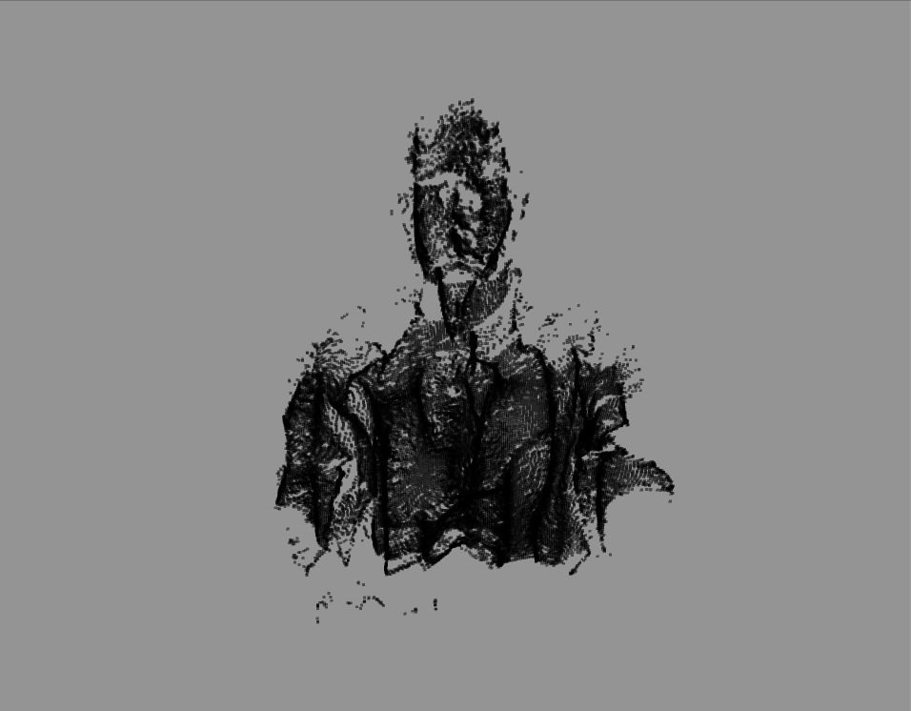
Reducing Artifacts Pt. 2 - Value System | 画像を掃除してる
Pixel Difference On
Pixel Difference On + Value System
Notes:
After some Post FX...

Slide 26
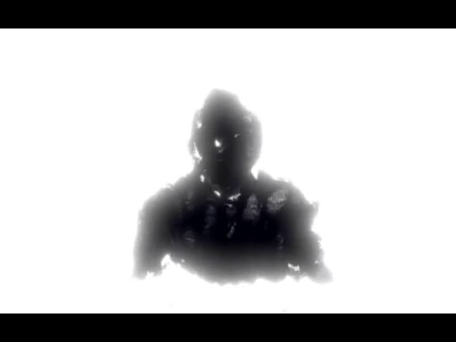

Slide 27
Future Implementation |将来にしたいです
Compute Shader
Increased Performance
Greater control of points on the point cloud
Multiple Kinects
Full body scanning
Modifying the “Shadow” based off user’s actions
Gesture recognition
Display as an actual mirror
Notes:
Where to next for me?

Slide 28

Thank you!
ありがとうございました

